Slide 1

Cyber Monday E-Commerce Platform
Welcome to the Cyber Monday E-Commerce Platform, created by
Team Kalyug
. Our mission is to provide an exceptional shopping experience optimized for the biggest online sales event of the year. Meet our talented team members who bring diverse expertise to this exciting project.
Team Members:
Avinash Kumar Roy
Jitesh Kumar
Nitin Kumar
Pratik Rauniyar

Slide 2
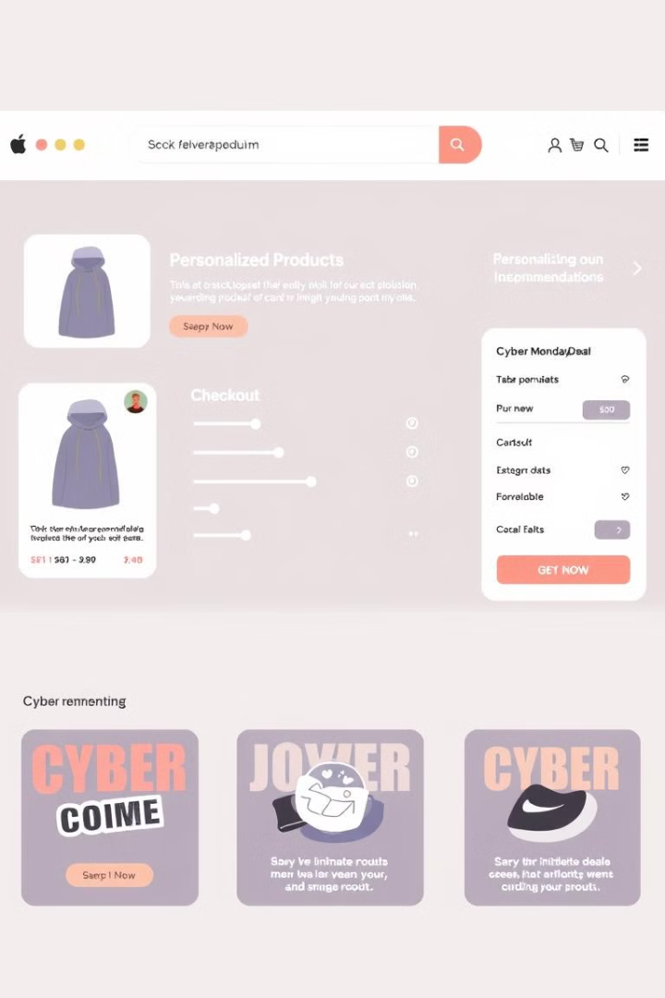
Project Overview and Objectives
1
Enhance User Experience
2
Optimize for Peak Traffic
Deliver a seamless and engaging shopping journey with exclusive Cyber Monday deals, personalized product recommendations, and a fast, secure checkout process.
Ensure the platform can handle the surge in traffic and sales during the Cyber Monday event without compromising performance or reliability.
3
Increase Conversions
Leverage data-driven insights and tailored marketing strategies to drive higher customer engagement and sales conversion rates.

Slide 3
Key Features and Functionalities
Cyber Monday Deals
Personalized Recommendations
Secure Checkout
Exclusive, time-limited deals and flash sales to drive customer excitement and urgency.
Streamlined, mobile-optimized checkout process with multiple payment options and enhanced security measures.
AI-powered product recommendations based on customer browsing and purchase history.

Slide 4
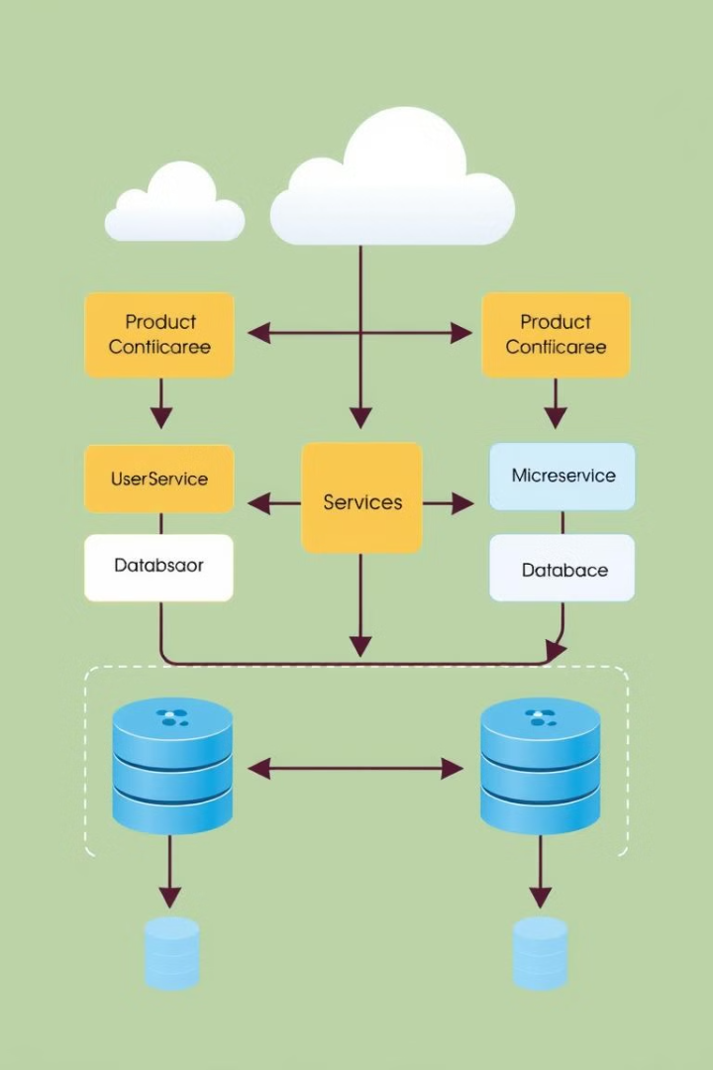
Technology Stack and Architecture
1
Front-end
React.js, Next.js, and TypeScript for building a modern, responsive user interface.
2
Back-end
Node.js, Express.js, and MongoDB for scalable and flexible server-side implementation.
3
Infrastructure
Leveraging AWS services like EC2, RDS, and CloudFront to ensure high availability and performance.

Slide 5
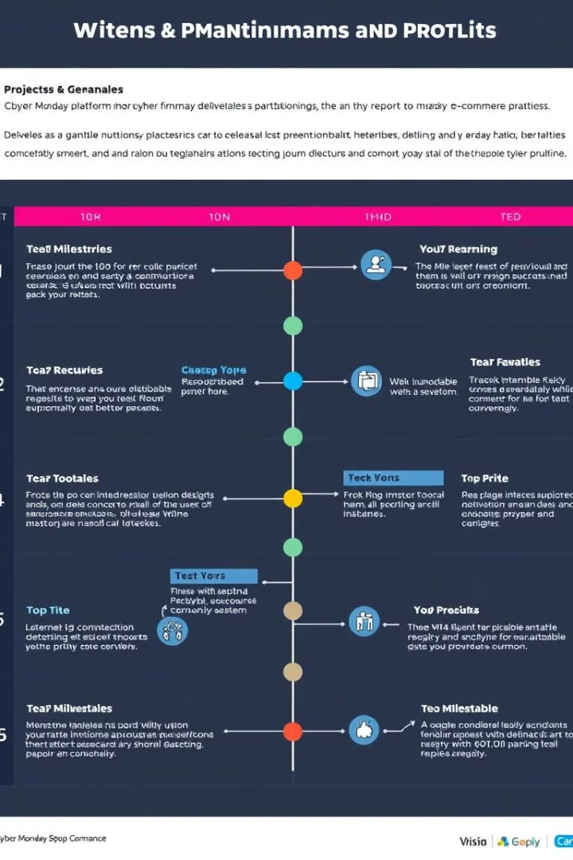
Project Timeline and Milestones
1
Discovery and Planning
Conduct market research, define requirements, and create a detailed project plan.
2
Design and Development
Design the user interface, implement core features, and integrate with third-party services.
3
Testing and Deployment
Perform comprehensive testing, optimize for performance, and deploy the platform to production.

Slide 6

Problem to Solve and Reference
High Traffic and Demand
Seamless User Experience
Cyber Monday is the biggest online shopping event, with a surge in website traffic and sales that can overwhelm e-commerce platforms.
Customers expect a smooth, fast, and personalized shopping experience, even during peak traffic periods.
Increased Conversions
Effective marketing strategies and tailored recommendations can drive higher customer engagement and sales conversion rates.

Slide 7
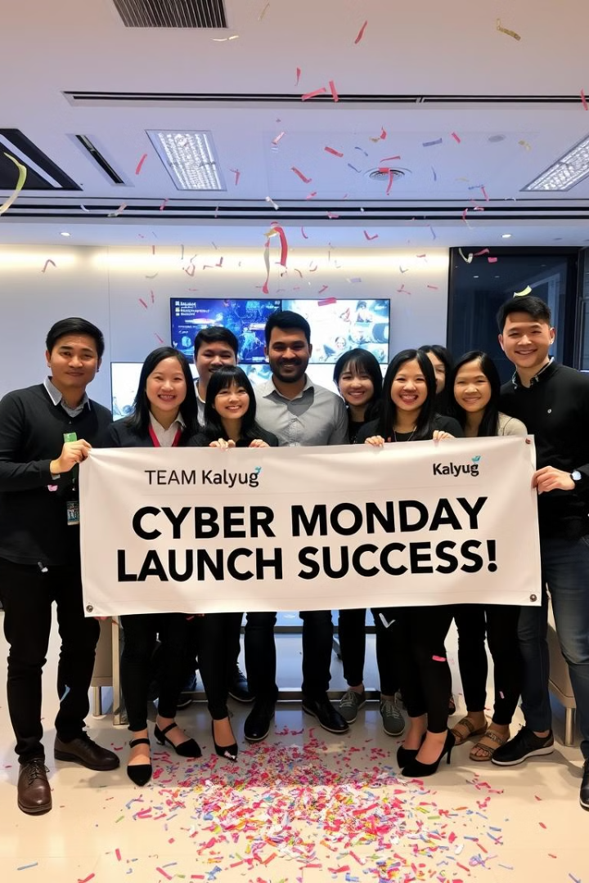
Thank You
Thank you for your time and attention. We are excited to bring our Cyber Monday E-Commerce Platform to life and help our clients achieve their sales goals. Please let us know if you have any further questions or feedback.

